Slide 1
Parking at the college
phase A -
By : Marwa Hamoud
Shady Mansour
Supervisor : Dr. Zeev Frankel
Notes:
Marwa
Welcome everyone in this presentation we are going to explain about our project -parking at the college that we worked on during the semester -
Our supervisor in this project is Dr. Zeev Frankel.
my partner is shady and i am marwa

Slide 2
Outline
The problem
Existing Parking Applications
Project goals
System architecture
System Workflow
Smart dealing with reservations
Use case
Measuring Project Success
Notes:
Marwa
the presentations outline will be as follows :
We will present at the first the problem and the limitations of Existing Parking Applications
the Project goals
the system architecture
the System Workflow
the Smart dealing with reservations
the Use case of our system
and at the end Measuring מיגרינג project success

Slide 3
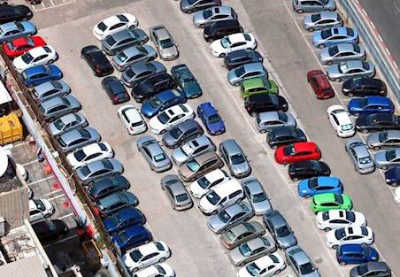
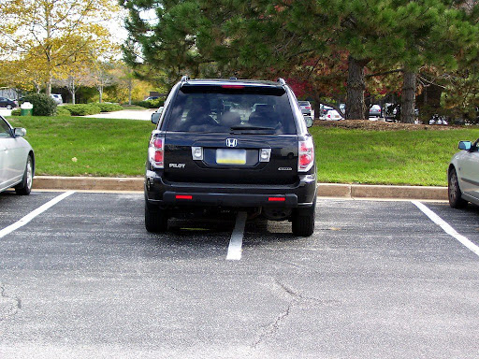
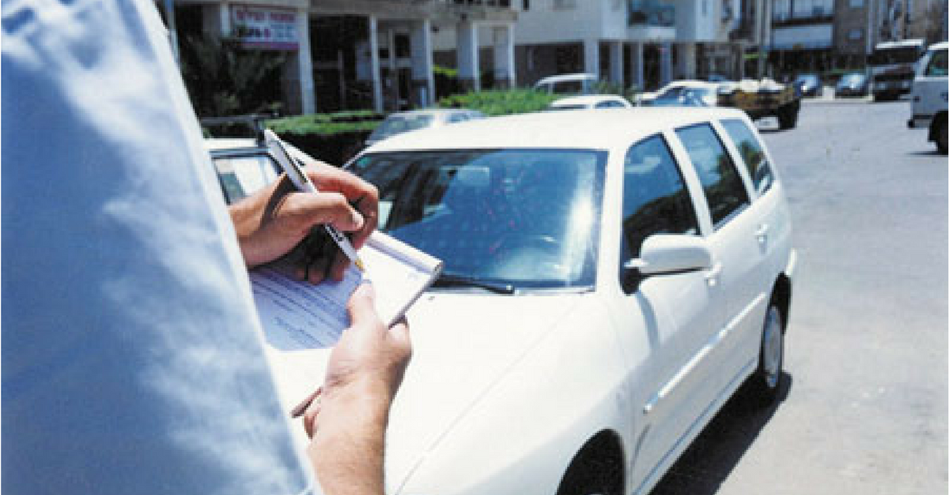
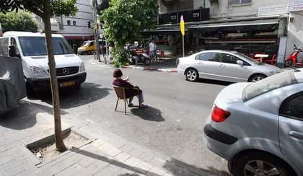
The Problem
Notes:
shady
In this slide, we see some of the main problems with parking: Double parking, illegally reserving parking spots, overcrowded parking lots, and fines caused by improper parking behavior.
these challenges are what our project aims to address with a smart technological approach, ensuring a more efficient and fair parking management system."

Slide 4
Existing Parking Applications
ParkMobile
SpotHero
Parkopedia
JustPark
PayByPhone Parking
Notes:
"shady
here are several parking management applications available in the market, but each has its limitations that restrict their efficiency and usability. Let me briefly highlight the main drawbacks of five popular apps:"
ParkMobile:
Not always updated with real-time parking availability.
SpotHero:
Limited to specific regions only.
Parkopedia:
Relies mostly on static information and lacks real-time updates.
JustPark:
Focuses on private parking spaces and is less relevant for large public parking lots.
PayByPhone Parking:
Designed solely for payments and doesn’t include reservations or availability information.
"These limitations highlight the need for a more comprehensive and efficient parking management solution, which our project aims to provide."

Slide 5
Project Goals
Optimize Parking Management
Fair Resource Allocation
Improve User Experience
Data-Driven Decision Making
Scalable and Adaptable System
Notes:
Marwa
Now that we've reviewed the limitations of existing parking management applications,
let me introduce the goals of our project.
The goal of our project is to create a smart parking management system that addresses the challenges of limited parking spaces.
1.We aim to optimize resource usage
2. ensure fairness פירניס in allocation
3.improve the user experience for both drivers and managers.
4.and we ensure data-driven decision-making while keeping the system scalable for future needs."

Slide 6
System architecture
Server
Manger interface
User app interface
Notes:
marwa
-"Here is a visual diagram of the system architecture, explain the connections between the main components קומפוננס:
Server: The central hub האב that processes requests, save data, and communicates with both the user and manager interfaces.
User App Interface: Allows לאוס users to send requests (e.g., check parking availability, make reservations) to the server and receive responses.
Manager Interface: Enables administrators to view system data, and manage operations effectively.

Slide 7
System Workflow
User requests Parking
Mobile app processes request
Server receives data
Check database availability
P ≥ Cutoff : confirm request
P < Cutoff : Reject request
Calculate priority (P)
Update Database + Notify user
Notes:
shady
"This diagram illustrates the complete workflow of our parking management system, focusing on how priority scores (P) are calculated and used to make decisions:
User Requests Parking:
The process starts when a user sends a request to reserve a parking spot through the mobile application.
Mobile App Processes Request:
The mobile application processes the user's request and forwards it to the server.
Server Receives Data:
The server receives the request and accesses the database to check the availability of parking spaces.
Check Database Availability:
The server verifies whether there are any free parking spots in the system.
Calculate Priority (P):
The system calculates a priority score (P) for the user based on predefined criteria, User type (Good, Neutral, or Bad).
Time of reservation (early vs. late).
Desired parking place (close vs. far).
Apply Priority Cutoff (P Cutoff):
If the user's priority score is greater than or equal to the cutoff (P ≥ Cutoff), the system approves the request and allocates a parking space.
If the priority score is below the cutoff (P < Cutoff), the request is rejected.
Update Database and Notify User:
Finally, the database is updated with the new allocation or rejection, and the user is notified about the decision in real time.
This workflow ensures that parking spaces are allocated fairly and efficiently, prioritizing good users while maintaining system transparency."

Slide 8
Smart dealing with reservations
Calculate priority value for the reservations (depending on user type and previous behavior)
Recalculate the system-wide cutoff threshold (based on the current state of parking availability, waiting list size, day of the week, time, and historical system performance) using Q-learning.
Accept/send to waiting list reservation according to this cutoff
Accept additional reservations from waiting list close to arrival time
Notes:
marwa
"in This slide explains how our system manages parking reservations.
at the first It calculates a priority value for each reservation depending on user type and past behavior.
then The system recalculate the cutoff value depending on current parking state, waiting list, time, and day of the week, through the Q-learning.
Reservations are accepted or sent to the waiting list based on this cutoff,
and additional reservations can be accepted close to the arrival time to maximize parking utilization יודליזישן. This ensures a fair,and adaptive process."

Slide 9
Smart dealing with reservations
Priority of reservation:
P=α⋅U+β⋅T+γ⋅L
U: User type
T: Time of reservation
L: Location type
α,β,γ: Weighting coefficients that balance the importance of user type, time, and location.
Notes:
marwa
This slide explains how we calculate priority (P) of the reservation
1. Priority Calculation (P):
the Formula: P = α·U + β·T + γ·L : priority is calculated as alpha times U plus beta times T plus gamma times L."
U: User type. good = 5 , pad =1 new =3
T: Time of reservation. => More than 5 days in advance = 5. Between 1 and 5 days in advance = 3. Maximum 1 day in advance = 1
L: Location type. close location=1 far location=5 middle location=3
α, β, γ: Predefined percentages פירסנטיגיס for example fifty% thirty% twinty%

Slide 10
Smart dealing with reservations
Q-learning based cutoff optimisation (simple case):
States (s):
s1: >80% parking spots available
s2: 50-80% parking spots available
s3: 20-50% parking spots available
s4: <20% parking spots available
Actions (a):
a1: Set cutoff=P₁
a2: Set cutoff=P₂
a3: Set cutoff=P₃
Notes:
shady
"In this slide, I will explain how we use the Q-Learning algorithm in our parking management system. The goal is for the system to learn how to make optimal decisions in a short amount of time.
Details:
States:
The States represent the percentage of available parking spots, from 0% occupancy to 100% occupancy.
Examples:
???????????????
Actions:
The system makes decisions based on the defined P_Cutoff values, using Q-Learning.
There are three main actions:
a1: Assign a parking spot to users above P_Cutoff1.
a2: Assign a parking spot to users above P_Cutoff2.
a3: Assign a parking spot to users above P_Cutoff3.
Using Q-Learning:
The system learns which Action to take for each State to optimize parking allocation.
Since the system needs to learn quickly, we kept the number of States and Actions small to speed up the process and ensure fast decisions.

Slide 11

Strategy efficiency calculation
Notes:
shady
This slide explains how we calculate efficiency (E) in our parking management system."
Efficiency Calculation (E):
Formula: E = (Accepted Reservations / Total Requests) - λ·W
Balances the percentage of successful reservations, total requests, and the average waiting time (W) with a penalty coefficient (λ) for long waiting times
Where:
Accepted Reservations: Number of reservations successfully processed.
Total Requests: Total number of reservation requests.
W: Average waiting time for users in the waiting list.
λ: Penalty coefficient for long waiting times.
"These calculations help the system make fair and efficient decisions while optimizing resource allocation."
-<< something about simple algorithm what you will use for compare,

Slide 12
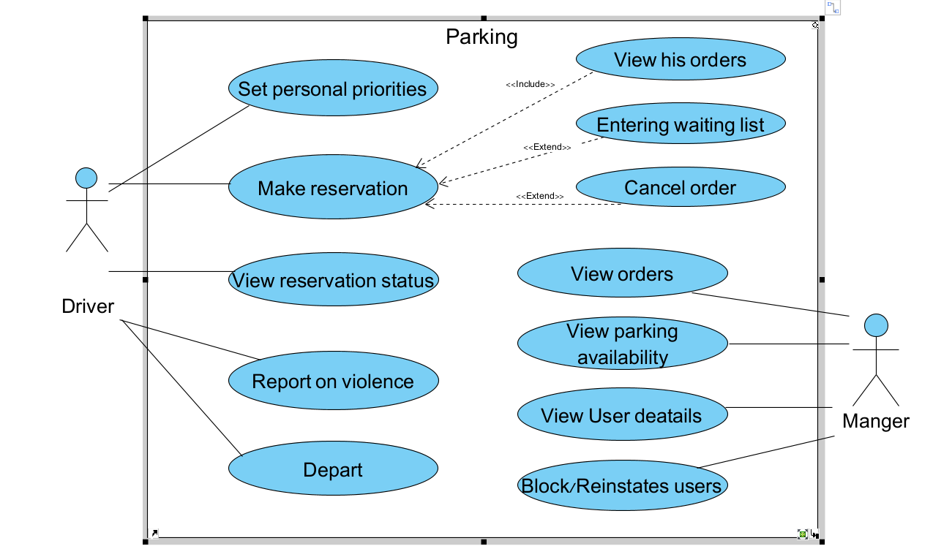
Use case
Notes:
shady
**"This slide presents the Use Case diagram of the system. It highlights the key actions of the two main user types:
Driver: Actions such as making reservations, checking status, reporting incidents, and departing.
Manager: Actions such as viewing user details, managing reservations, blocking users, and overseeing availability.
The diagram emphasizes the connections between the users and the system's main functionalities."**

Slide 13
Measuring Project Success
Functional GUI
System Input Processing
Algorithm Performance
Data Accuracy and Consistency
Notes:
marwa
"This slide presents the tests we will use to measure מאגר the success of our project.
Functional GUI:
We will check that the user interface is easy to use and works correctly .
System Input Processing:
The system must receive and process data correctly without errors.
Algorithm Performance:
We will test if the algorithm works as expected, even in complex cases like more than one user made reservations at the same time or new rules being added.
Data Accuracy אקיורסי and Consistency קונסיסטנסי :
We will ensure the system save data correctly קורקטלי , without errors,
, or lost information.
These tests will help us to confirm that the system meets all requirements ריקוימנטס in the next development דיואילמינט phase פאיס .

Slide 14
Thank you for your attentions!
Any questions?
Notes:
marwa

